Slide 1
Patient Reviews of Antidepressant Drugs Across Multiple Domains
JOE STOICA, CONOR DEVINS, EUGENE KIM

Slide 2
RESEARCH OBJECTIVES
According to the World Health Organization, depression is the leading cause of disability and disease burden worldwide.
There is a considerable number of different pharmacological treatment options.
Research objectives:
1. Identify predominant choice of antidepressant drug types and brands.
2. Examine patients’ risk/benefit evaluations across varying treatment options.
3. Examine relations between multiple aspects of patients’ treatment
experience/evaluation.

Slide 3
DATA OVERVIEW
Source: Drug Review Dataset from UCI Machine Learning Repository
Patient reviews on drugs for treatment of various conditions (pooled from multiple web-sites).
Variables:
— Drug Brand Name
— Drug Classification (e.g. SSRI, SNRI, Other)
— Condition (filtered 499 cases where reason for treatment is depression)
— Effectiveness (5-step ordinal response: 1 (Ineffective) to 5 (Highly Effective)
— Side Effects (5-step ordinal response: 1 (Extremely Severe) to 5 (None)
— Overall Satisfaction (10 star patient rating)
— Benefits Review (patient written response)

Slide 4
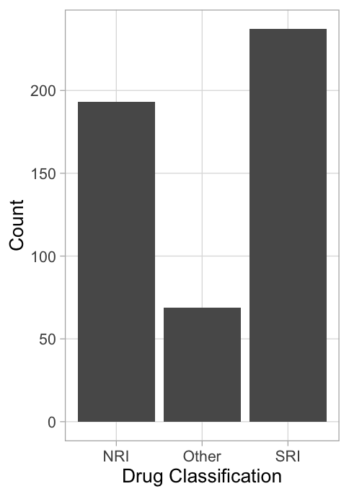
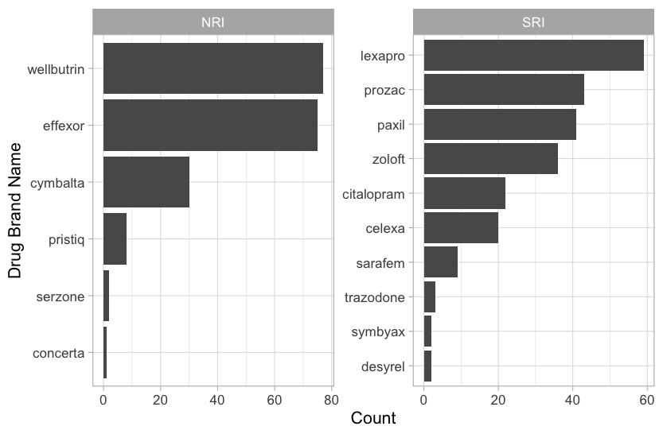
CHOICE IN DRUG TYPE AND BRAND
Count
Drug Brand Name
Drug Classification
Count

Slide 5
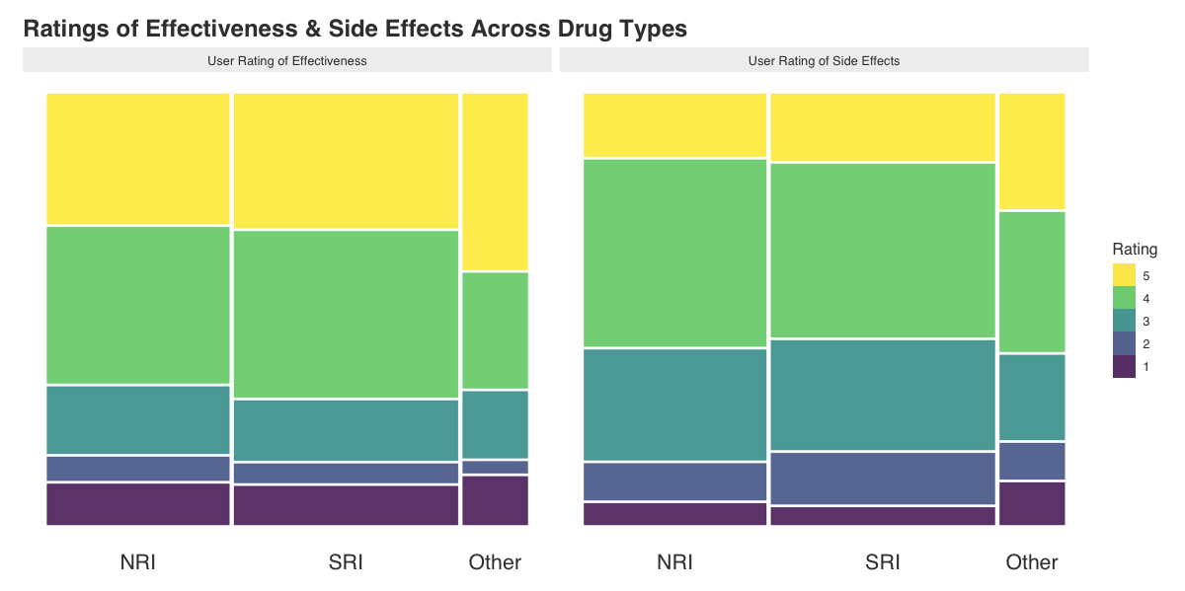
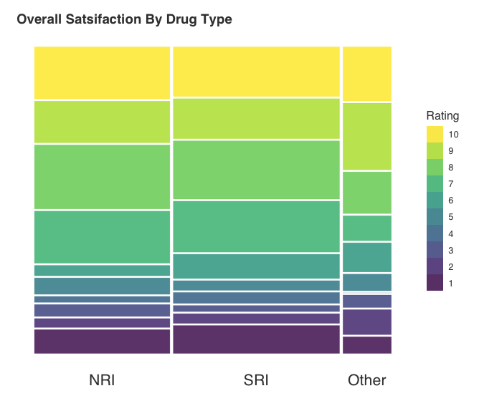
COMPARISON BY DRUG TYPE
Effectiveness
Side Effects
Drug Classification
Drug Classification
Effectiveness (1 = Ineffective … 5 = Highly Effective)
Side Effects (1 = Extremely Severe … 5 = None)

Slide 6
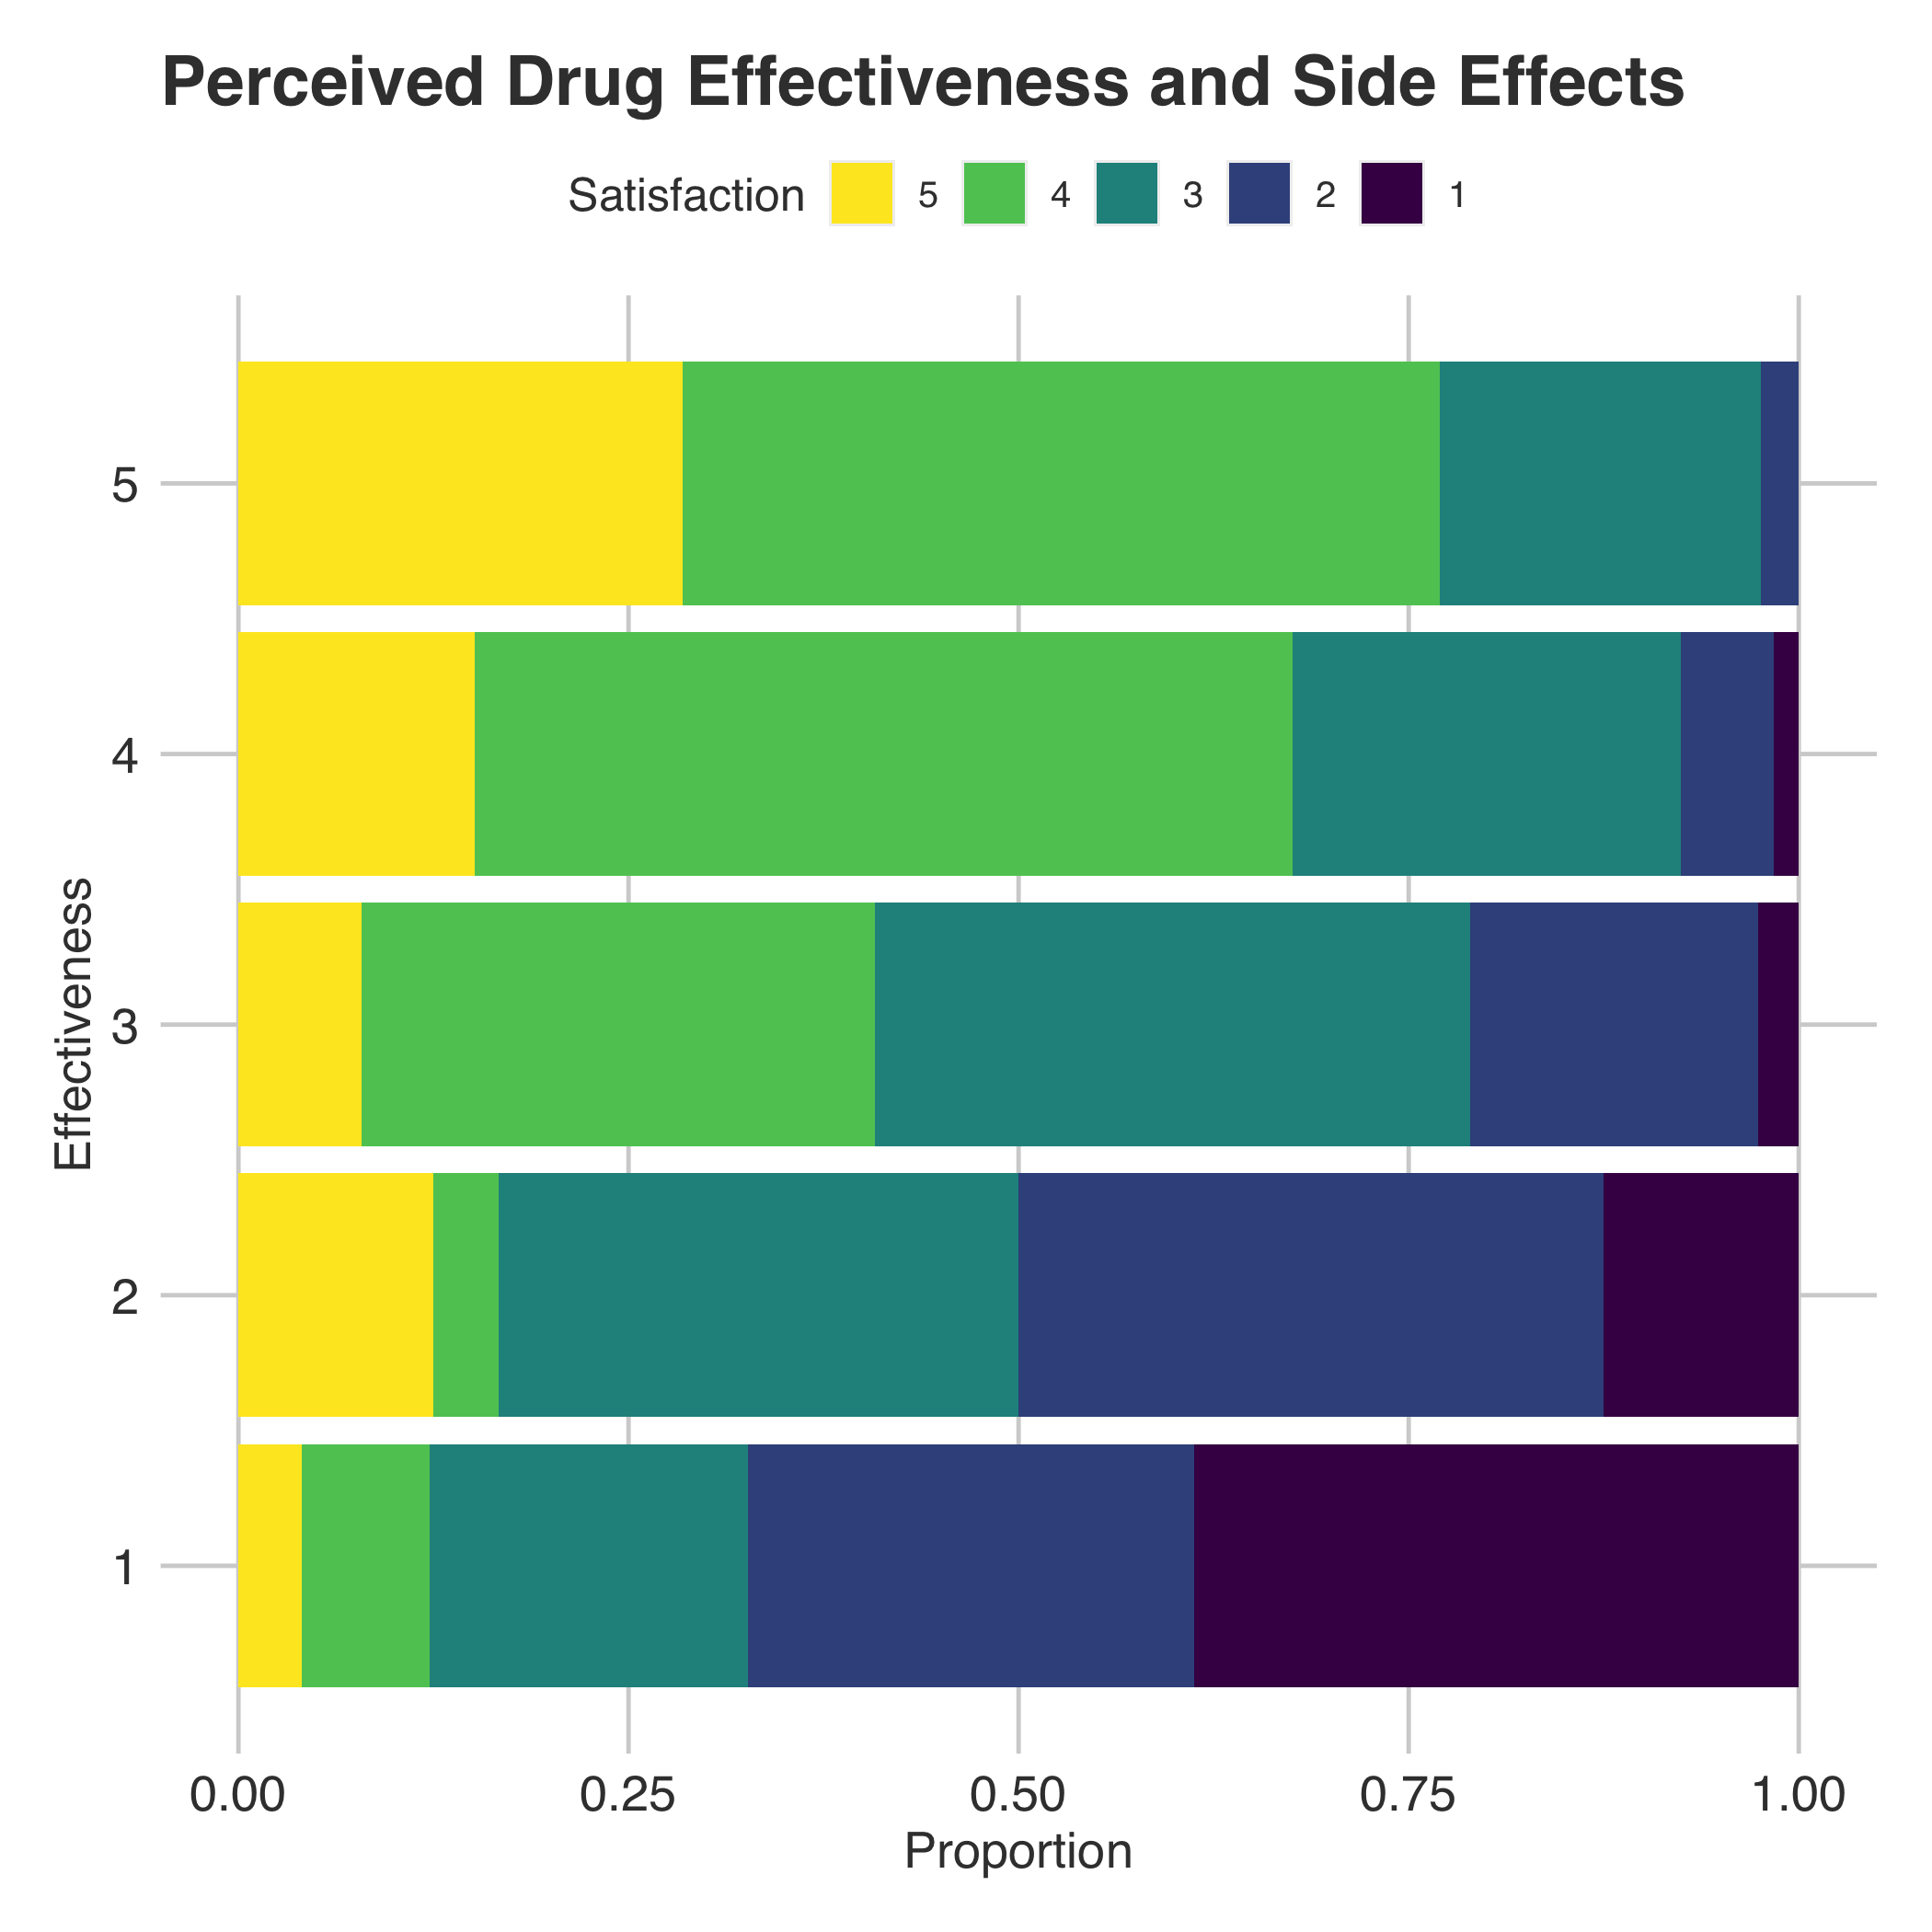
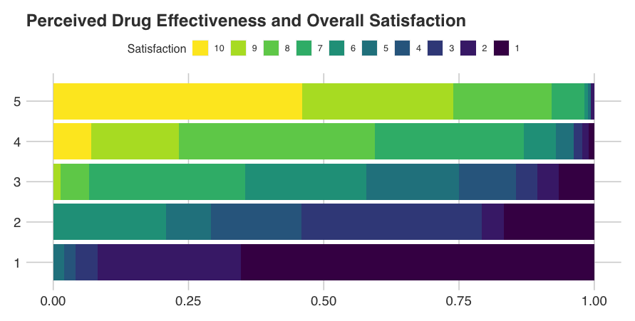
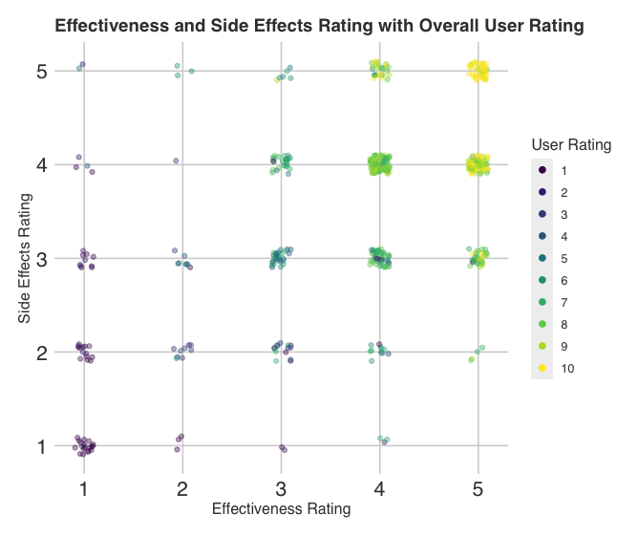
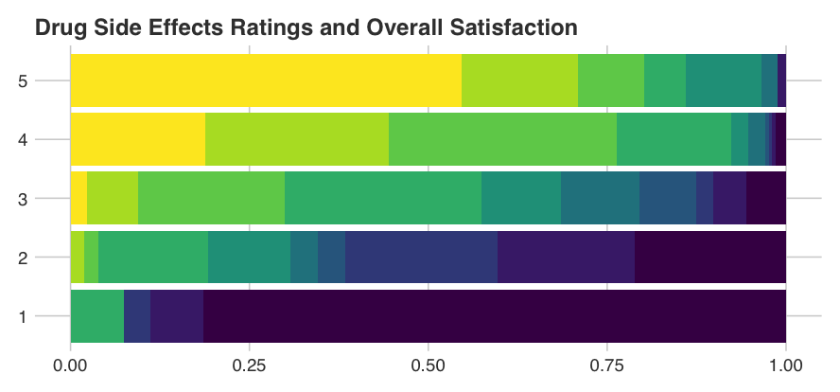
RELATIONS BETWEEN DRUG EVALUATIONS
Effectiveness Rating
Side Effects Rating
Effectiveness (1 = Ineffective … 5 = Highly Effective)
Side Effects (1 = Extremely Severe … 5 = None)
Proportion

Slide 7
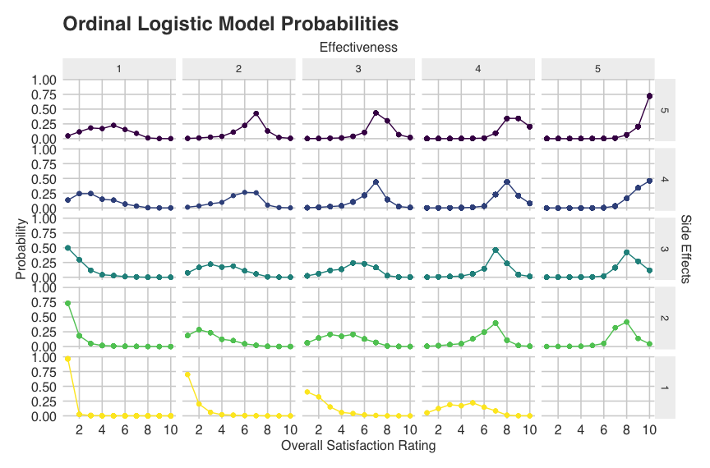
PRELIMINARY MODELING
Proportional Odds Logistic Regression (Overall Satisfaction ~ Effectiveness + Side Effects)
Residual Deviance: 1331.743
AIC: 1365.743

Slide 8
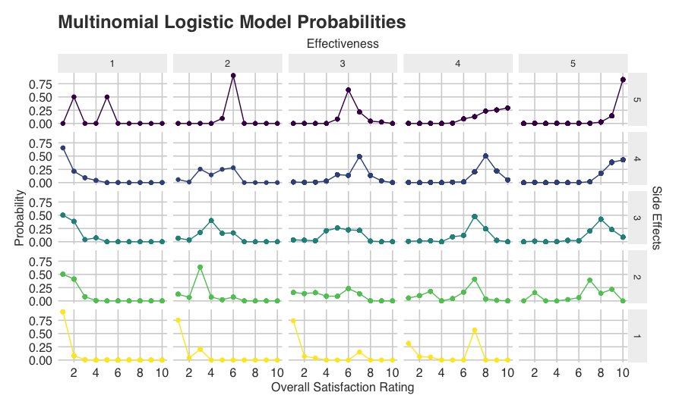
PRELIMINARY MODELING
Multinomial Logistic Regression (Overall Satisfaction ~ Effectiveness + Side Effects)
Residual Deviance: 1218.239
AIC: 1380.239

Slide 9
CONCLUSIONS
SSRIs and SNRIs accounted for the overwhelming majority (86%) of all cases.
Different classes of drugs are remarkably similar in their evaluation profiles.
Patient perceptions of drug effectiveness appear to be related to experienced severity of side effects.
Perceived effectiveness and side effects severity are jointly predictive of patients’ overall satisfaction with drug treatments.

